Slide 1

BookBoxBook
team GoNaMi
Hoyun Ko
Yuseon Nam
Seungyun Lee

Slide 2

Integrated service
for trading used books
between univ. students
BookBoxBook
Notes:
북박북은 대학생을 위한 중고책거래 서비스다

Slide 3
Index
01
Progress
02
Further Schedule
03
Q&A

Slide 4
1
Progress

Slide 5


Progress
BBB
Apppication
BookBoxBook
BookBox

Slide 6



Application
1. Transaction state
B.B.B
have trouble with…
other functios implementations

Slide 7
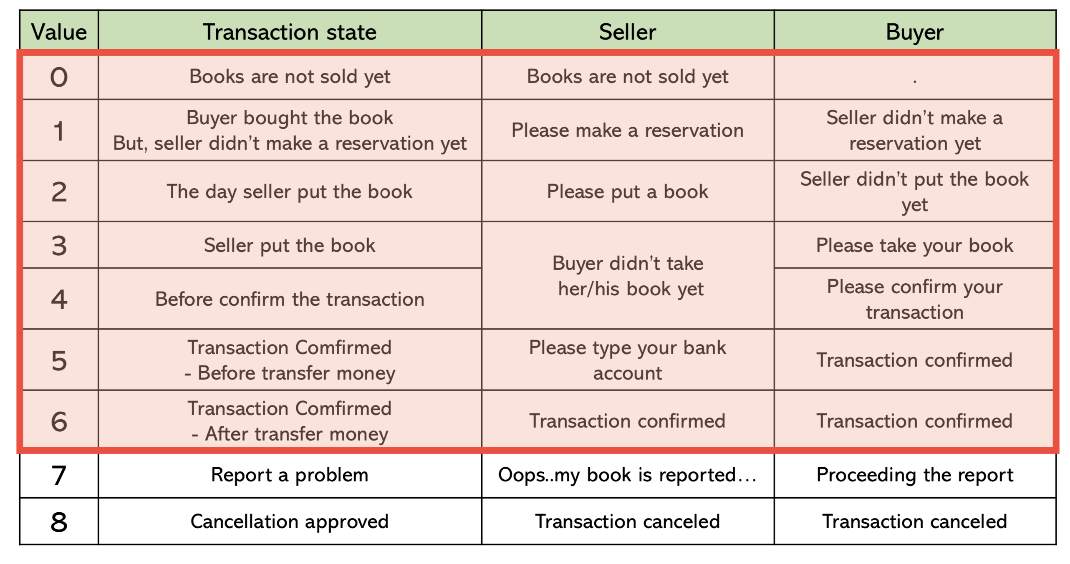
1. Transaction state

Slide 8

BookBox (Hardware)
1. Book Box(cabinet)
2. Barcode Recognition
3. DB Modification
4. Decode Barcode

Slide 9
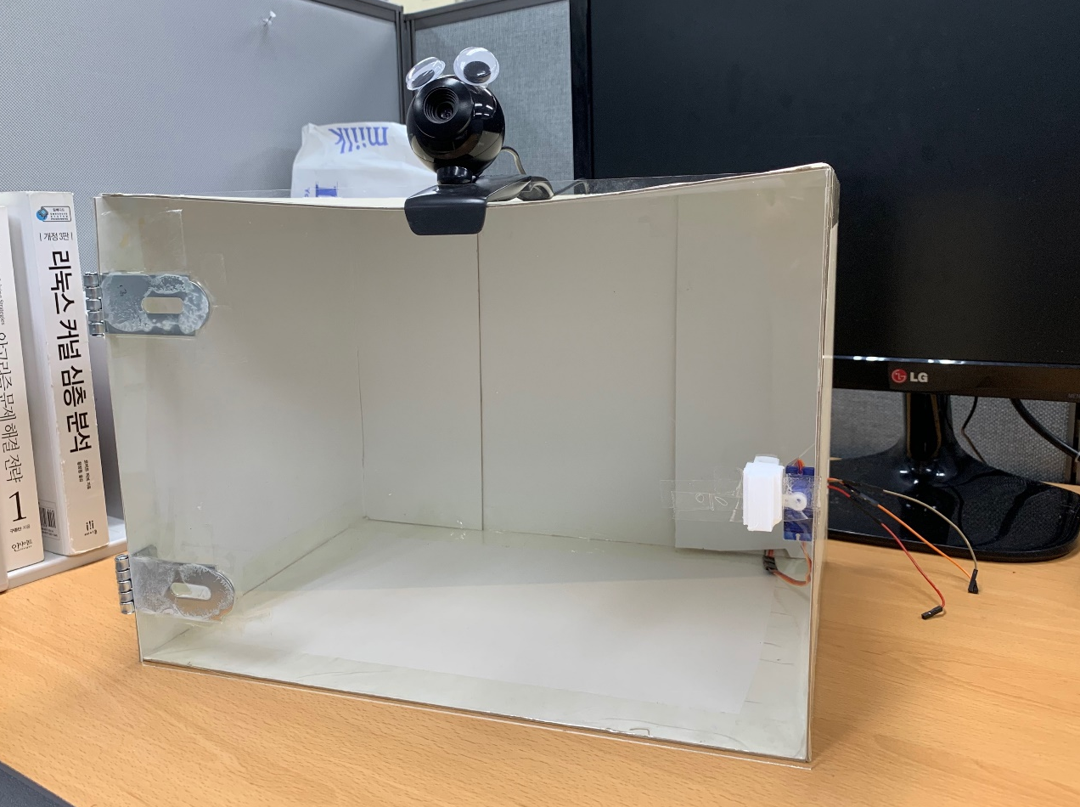
1. BookBox (cabinet)
a.
a. Camera
- recognize QRcode, Barcode
b.
b. Locker
- lock & unlock the door

Slide 10
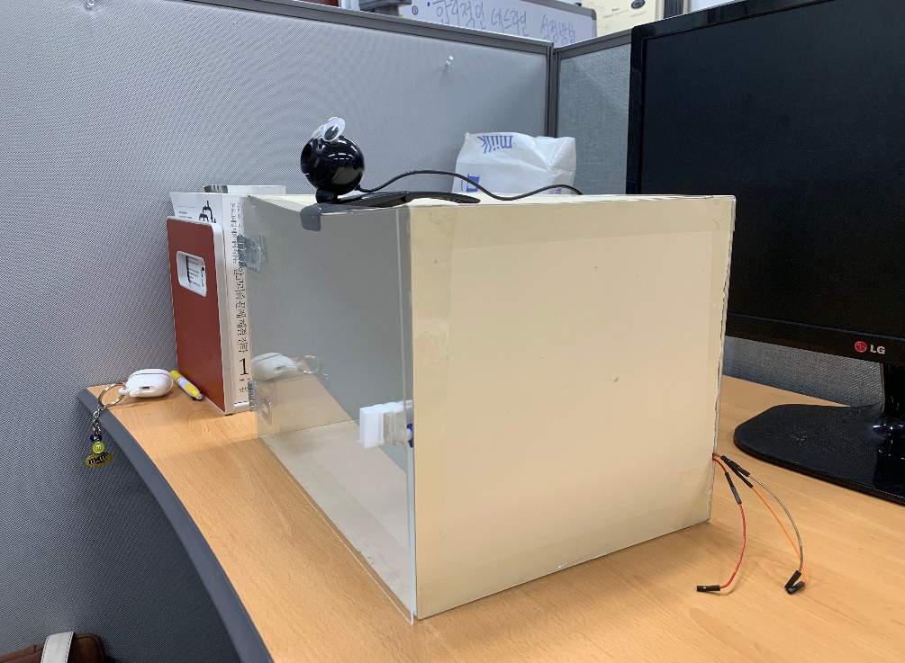
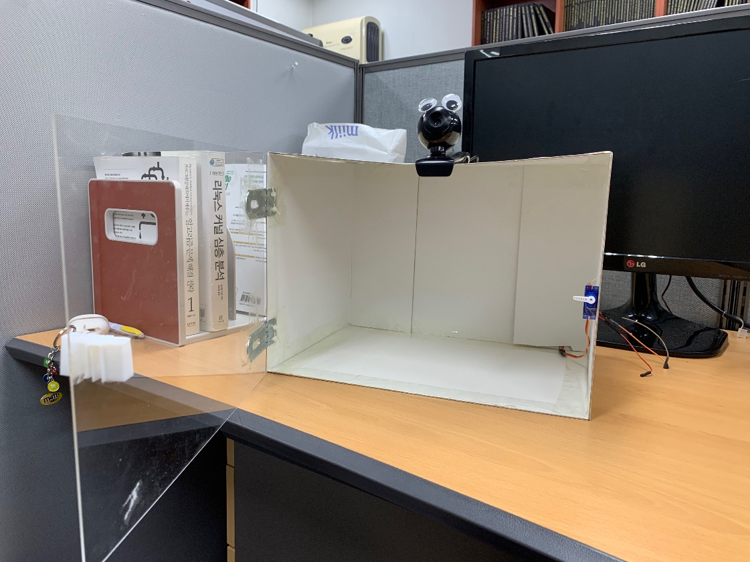

1. BookBox (cabinet)
side
door-opened

Slide 11
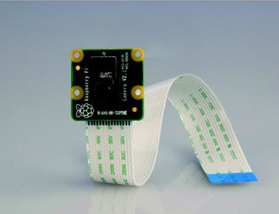
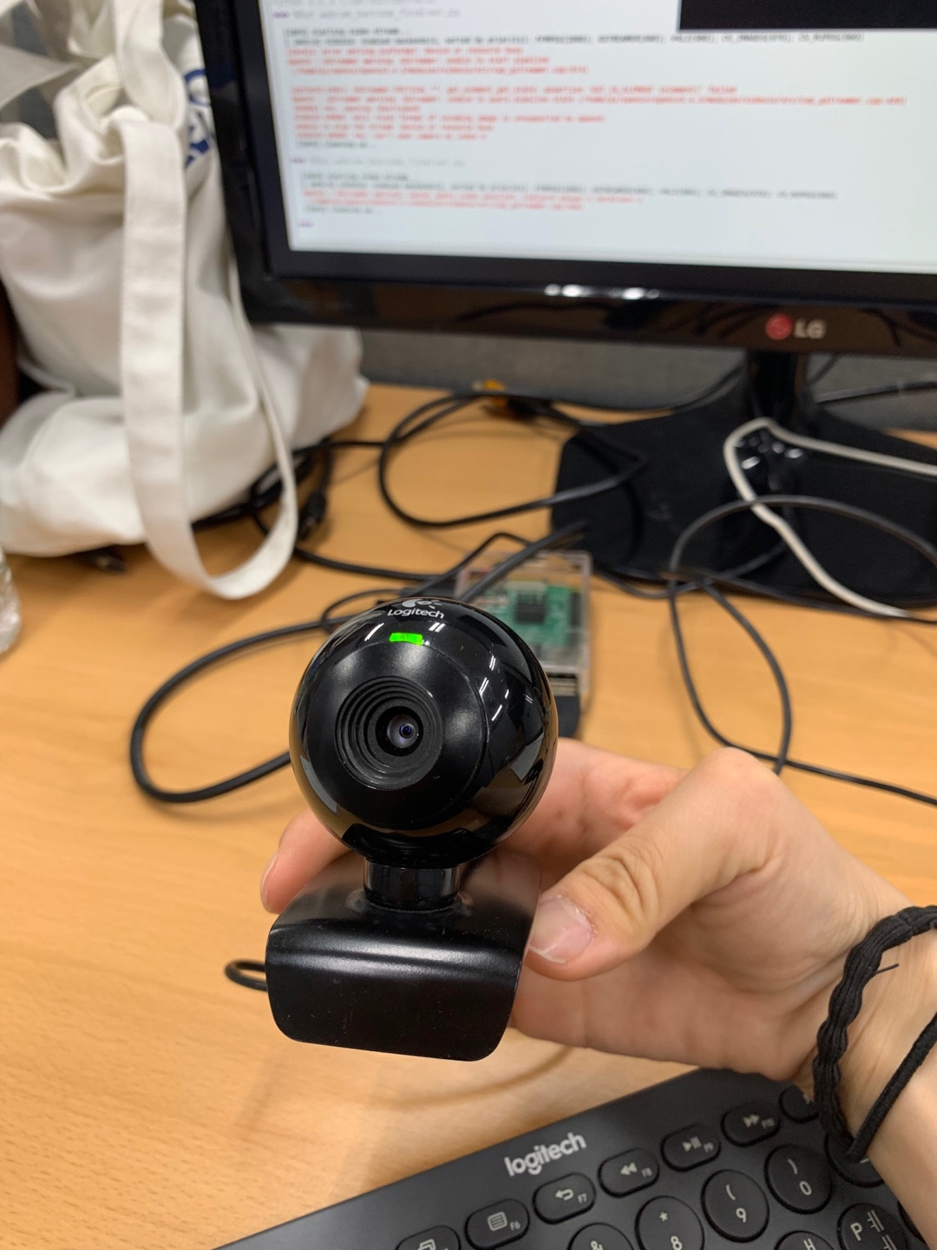

2. Barcode Recognition
(using webcam)
raspberry pi camera module
Logitech web camera
Bad Auto Focus

Slide 12
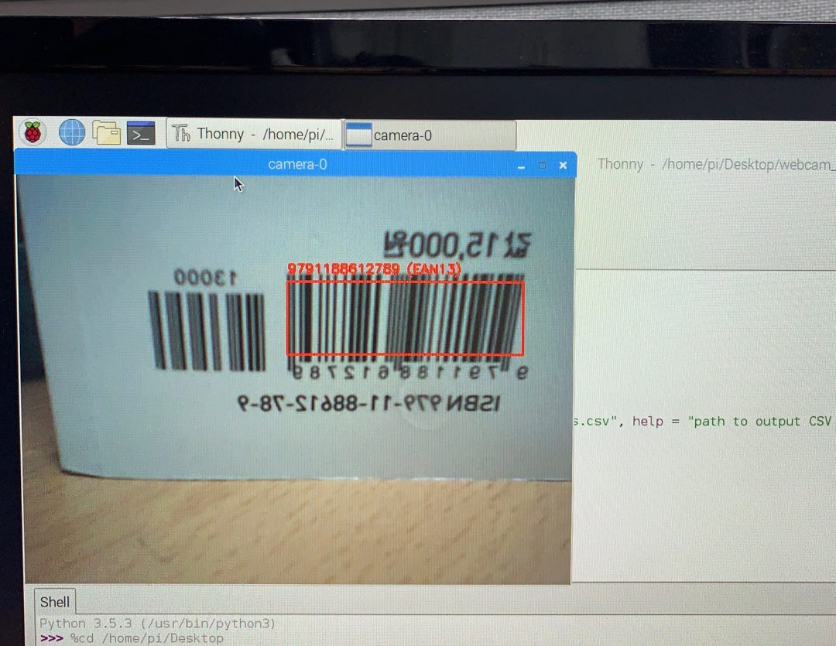
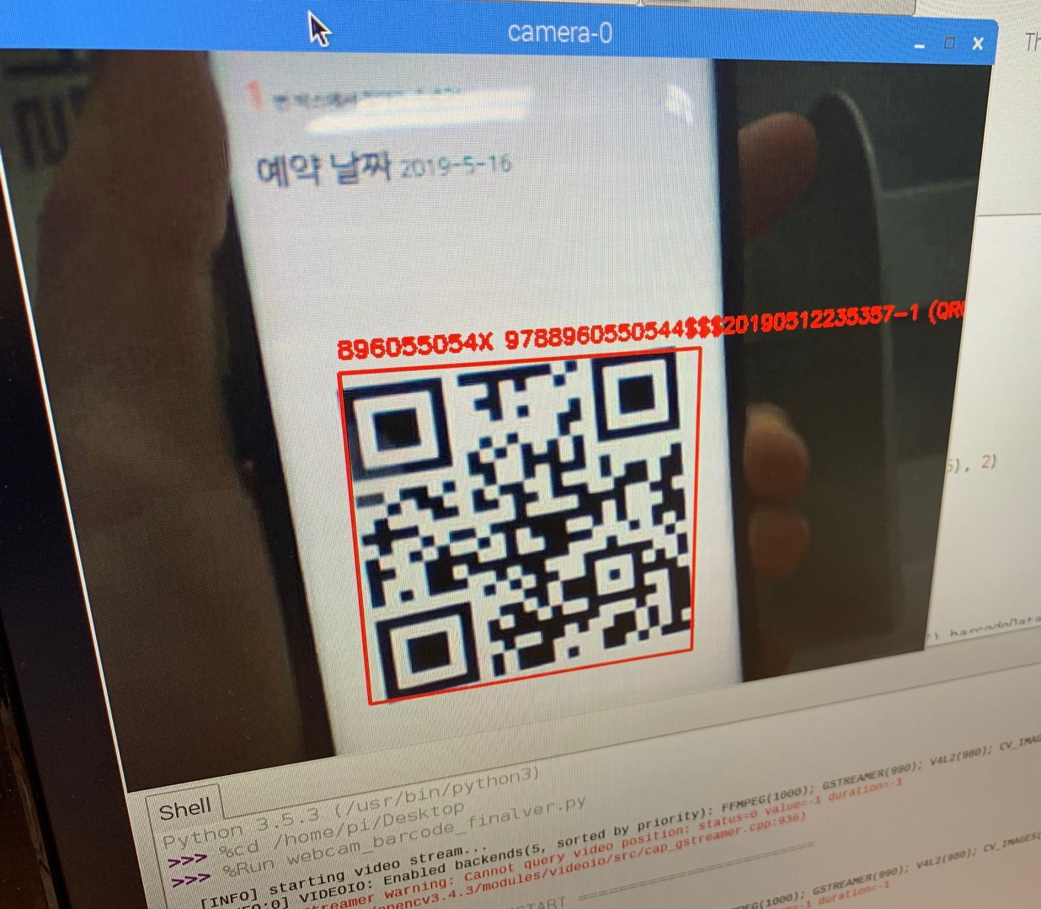
2. Barcode Recognition
(using webcam)
Successfully Recognize Barcode as well as QRcode

Slide 13
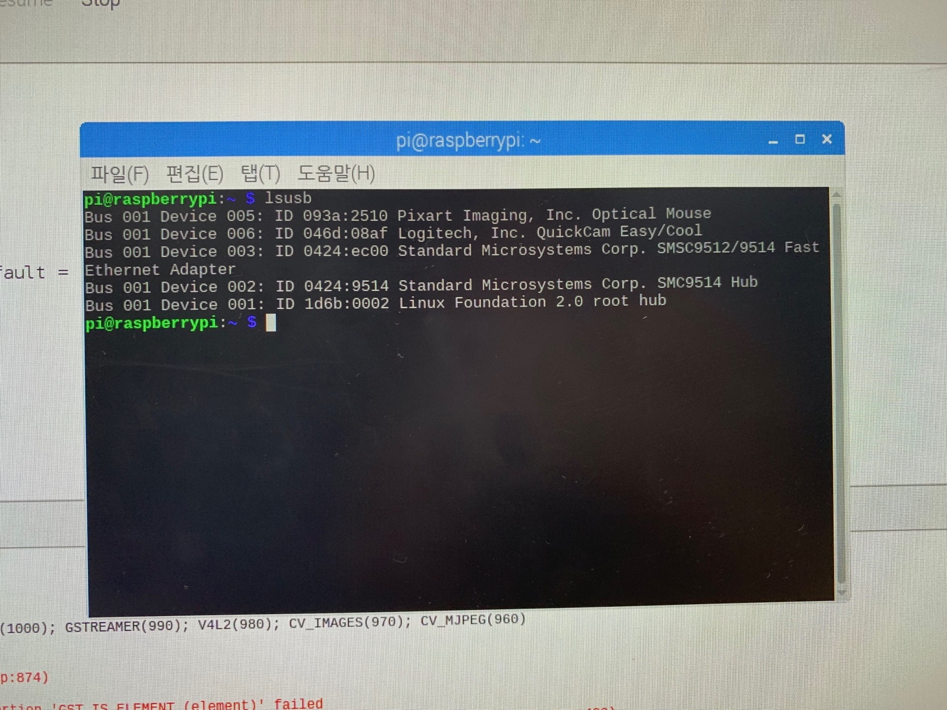
2. Barcode Recognition
(using webcam)

Slide 14

3. DB Modification
- To access DB from Raspberry pi
Server based DB
based DB

Slide 15
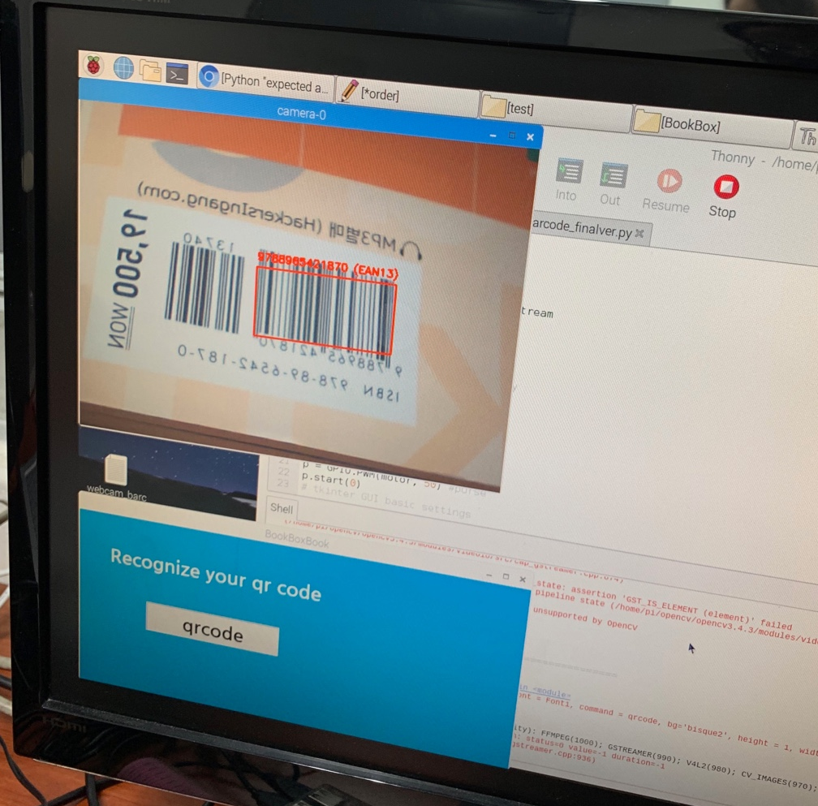
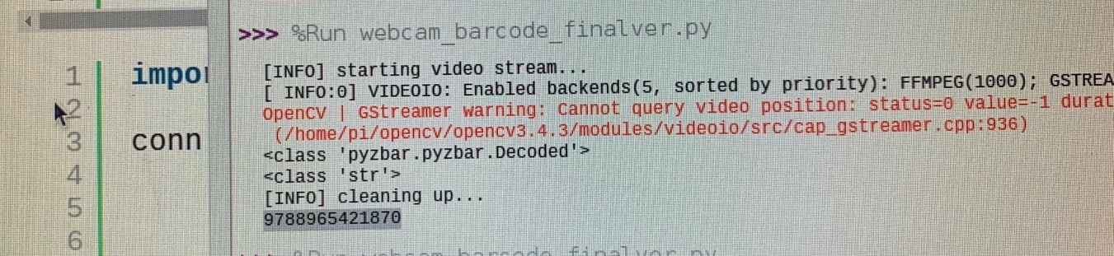
4. Decode Barcode
ISBN
: 9788965421870
Successfully
Decode!

Slide 16
2
Further Schedule

Slide 17
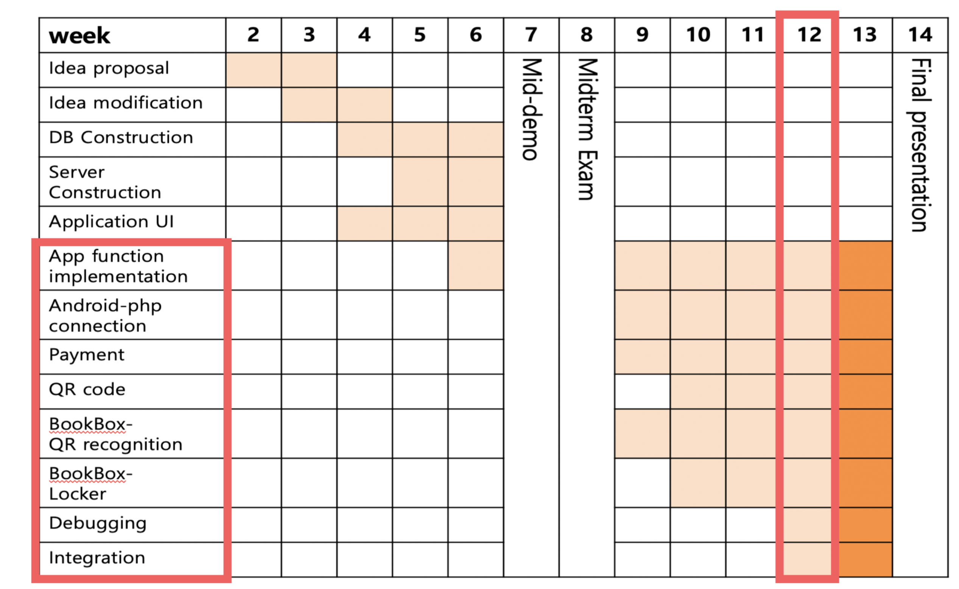
Last week

Slide 18
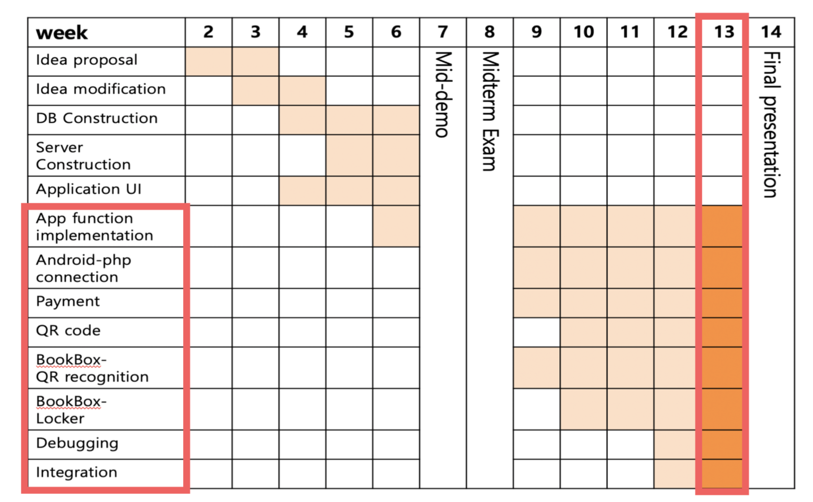
This week

Slide 19
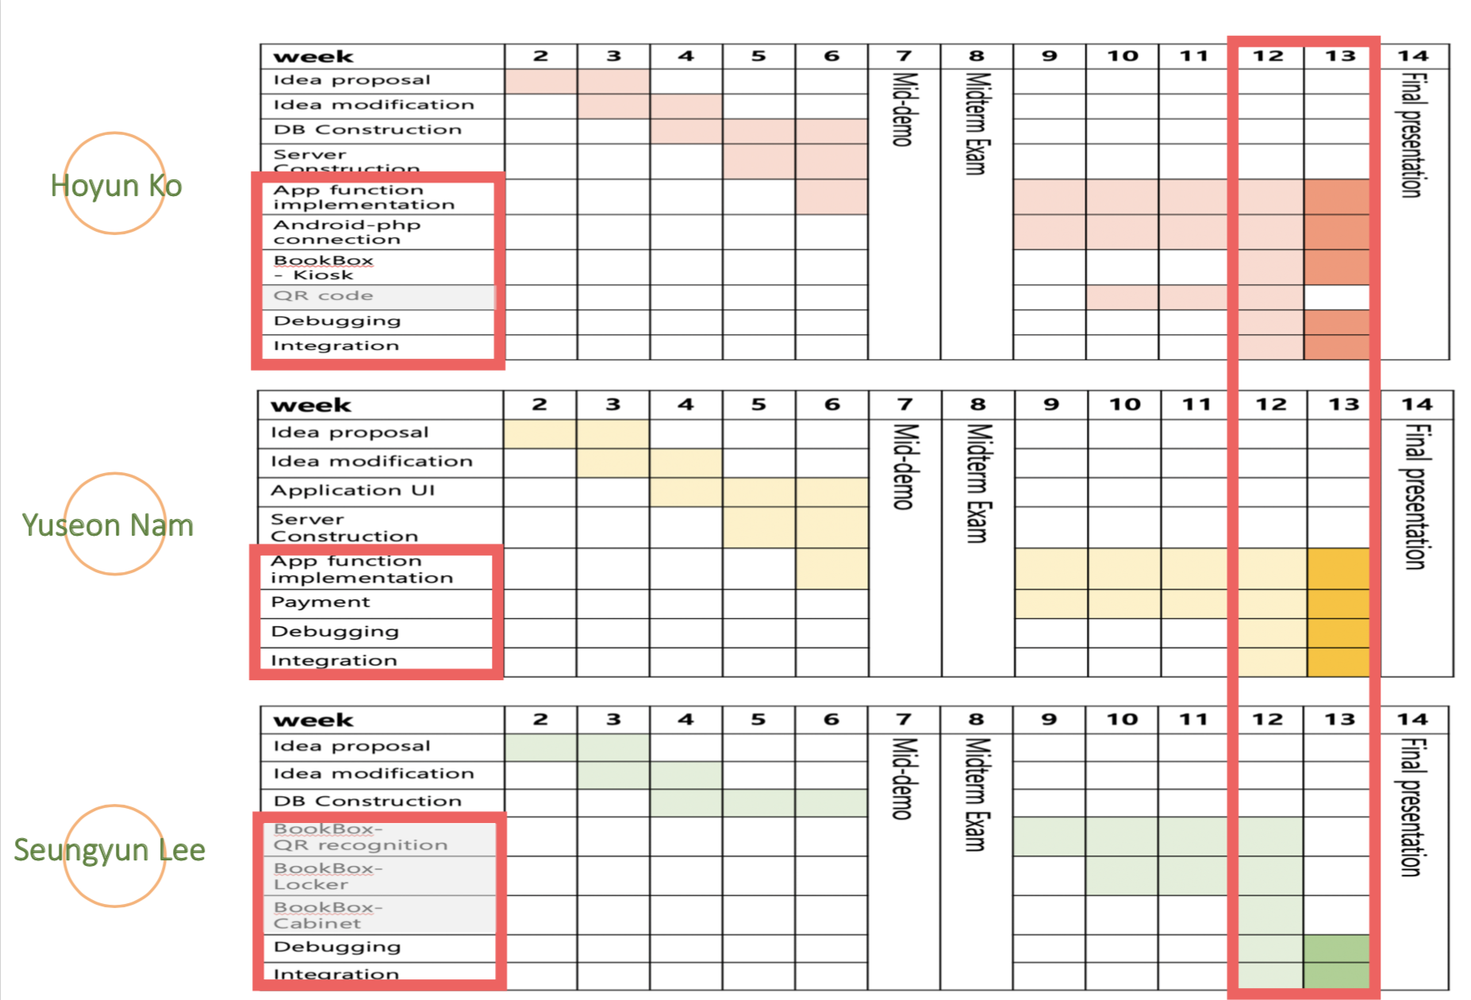

Slide 20
Q&A

